Slide 1
Using Bayesian Optimization in Pose Graphs Based SLAM 16th July
Zuxun Wang

Slide 2
Progress Since Last Meeting
Collect results for GPS system enabling proposition 4
Generate surface plots for linear systems and GPS systems
Compute Consistency Measurement Value for VehicleTracking
BayesOpt in MATLAB
Modify code structure

Slide 3
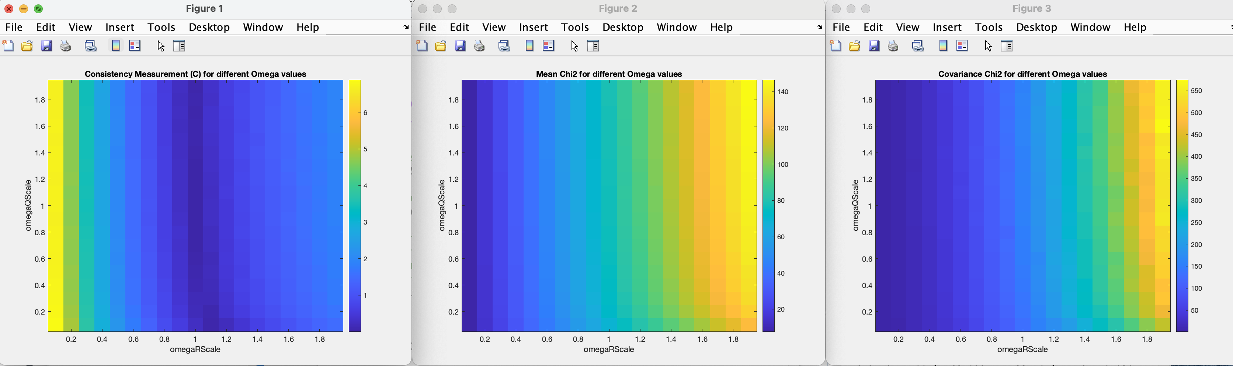
GPS System Results (Enabling Proposition 4)
Consistency
Mean
Cov

Slide 4
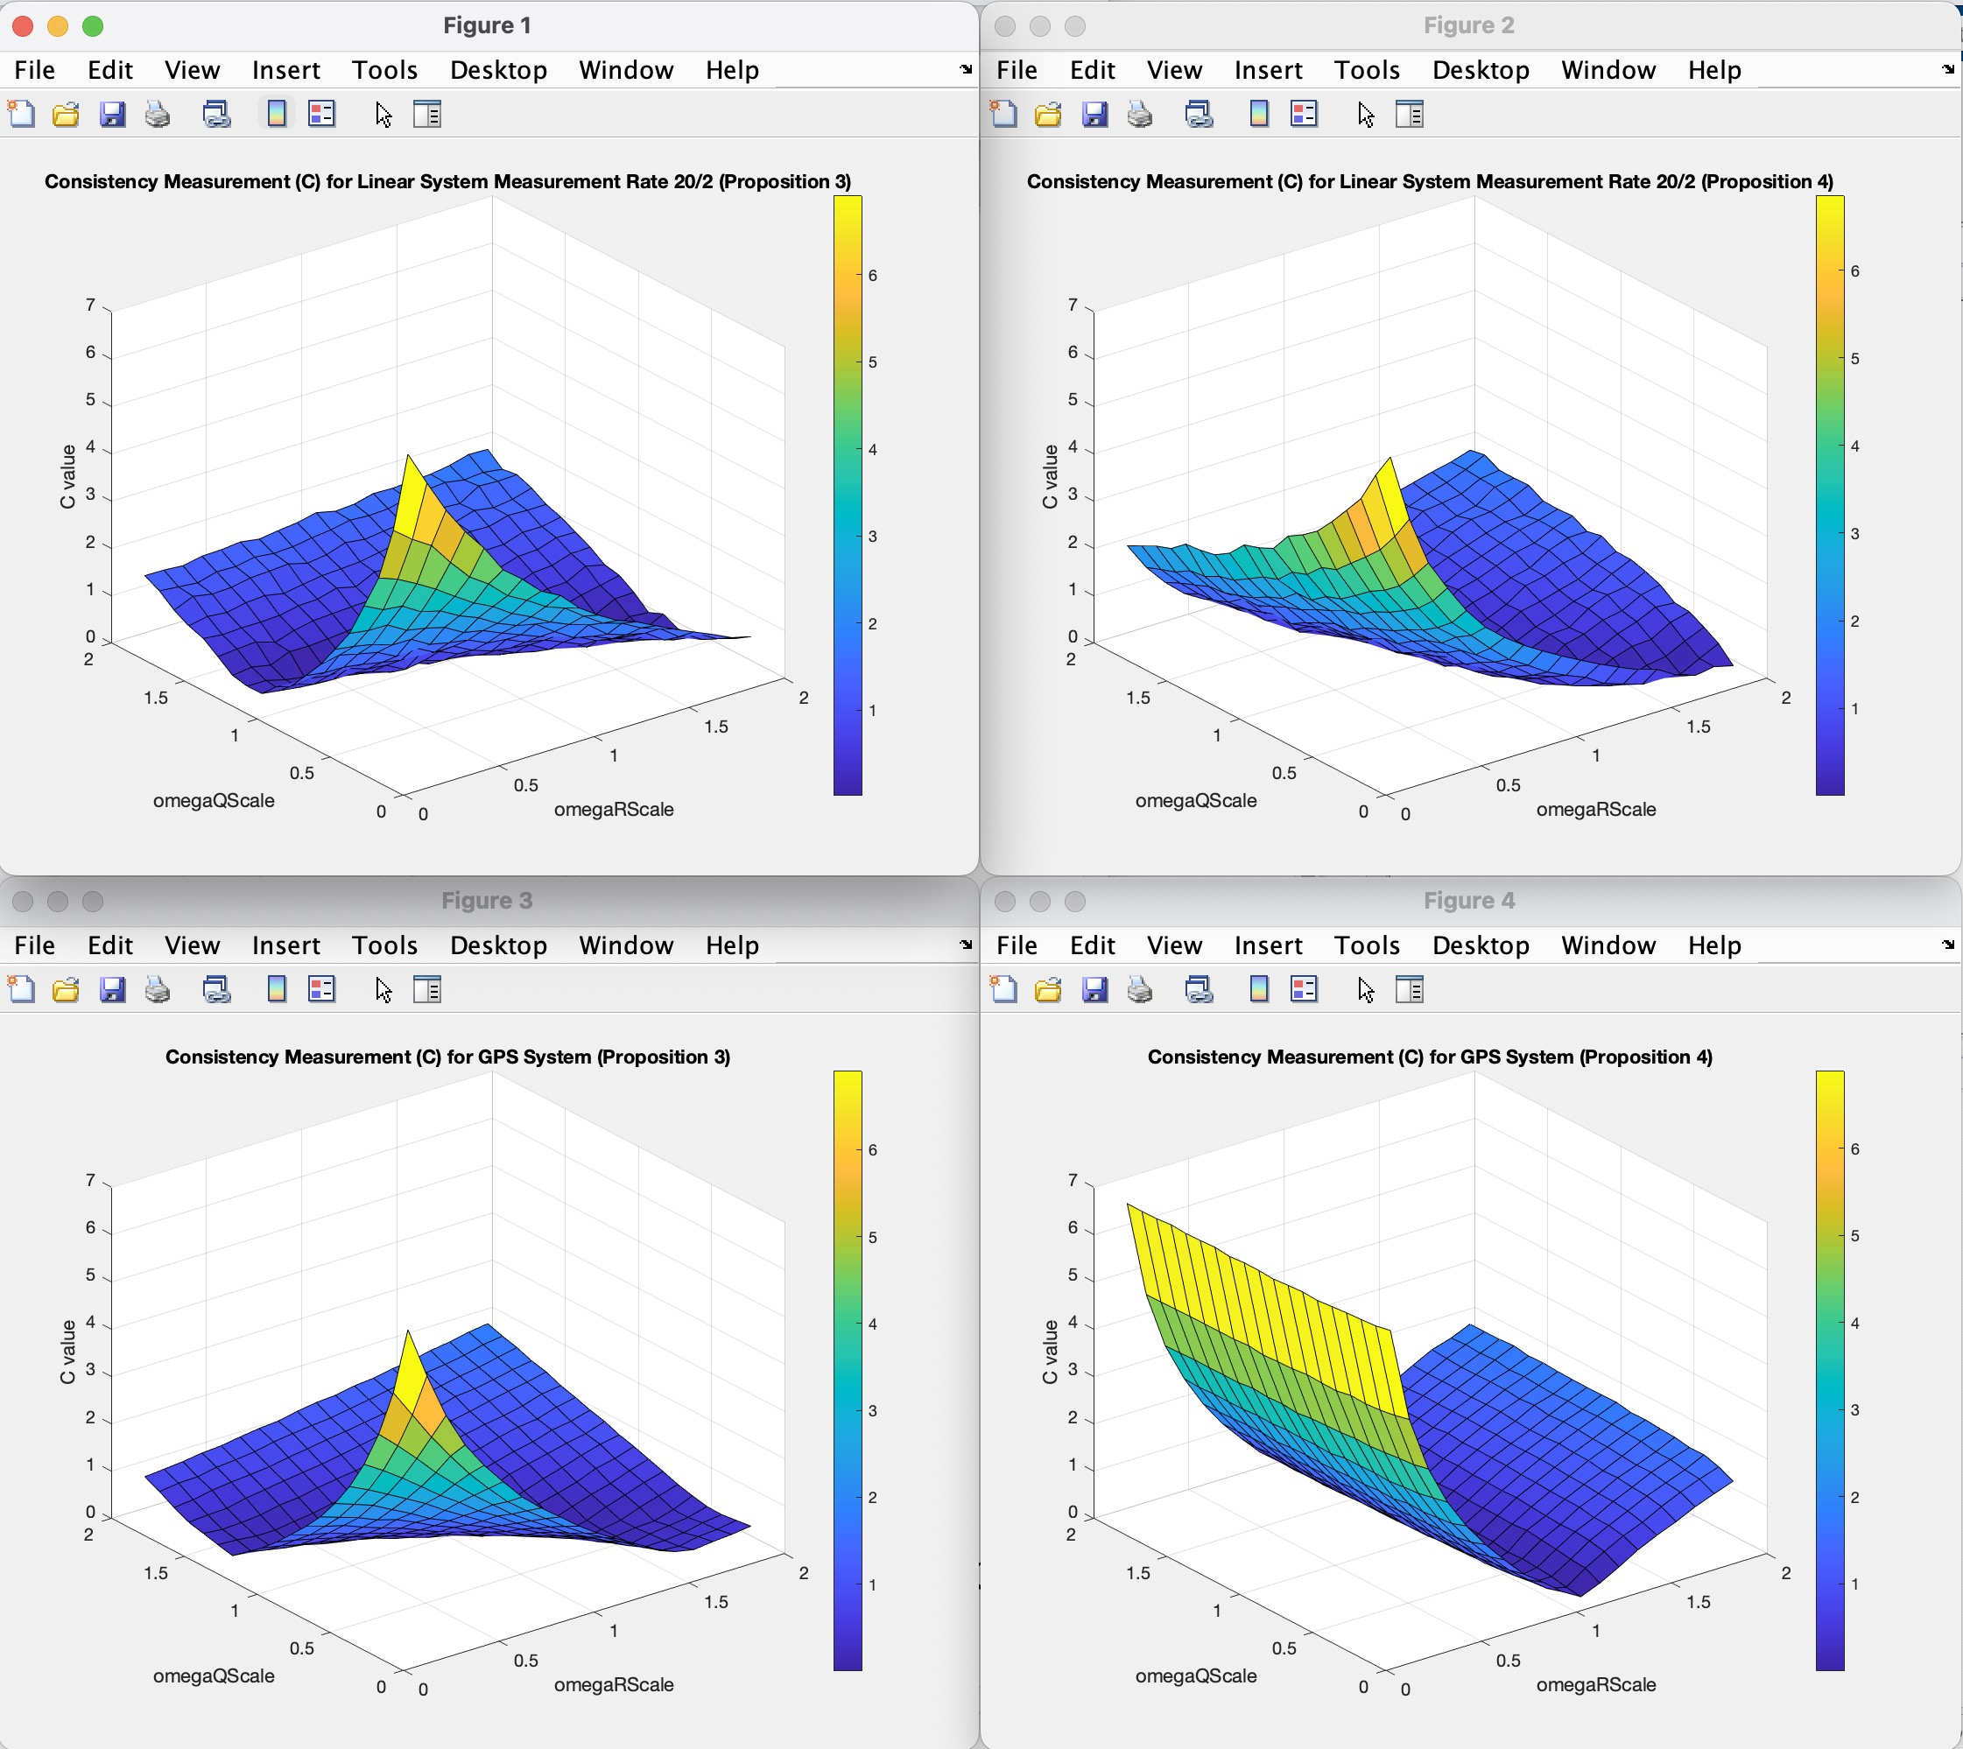
Surface Plots for Linear and GPS Systems

Slide 5
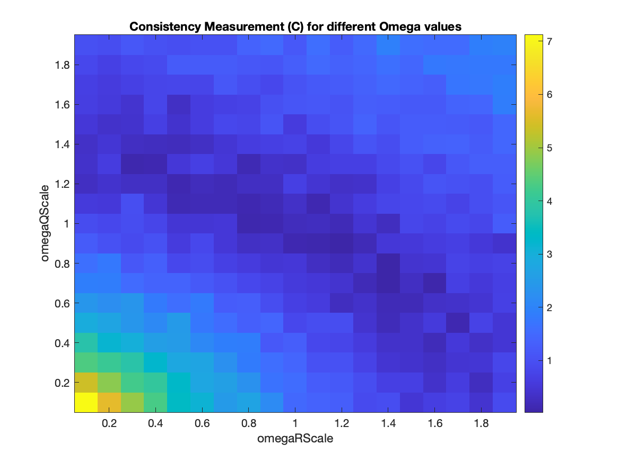
Consistency Measurement Metric for Landmark Vehicle Tracking
Total number of timestep: 20
Number of episodes: 100
Number of Landmarks: 200;
Extent: 300;
numObs: /
obsPeriod: /

Slide 6
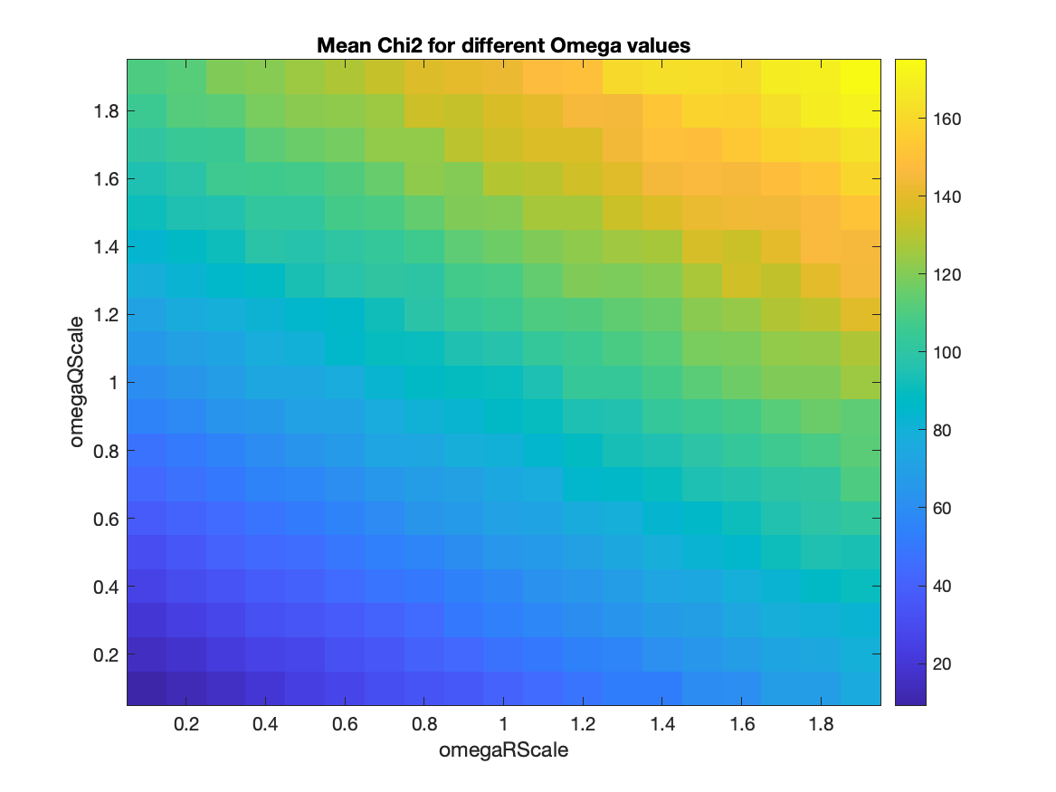
MeanChi2 for Landmark Vehicle Tracking
Total number of timestep: 20
Number of episodes: 100
Number of Landmarks: 200;
Extent: 300;
numObs: /
obsPeriod: /

Slide 7
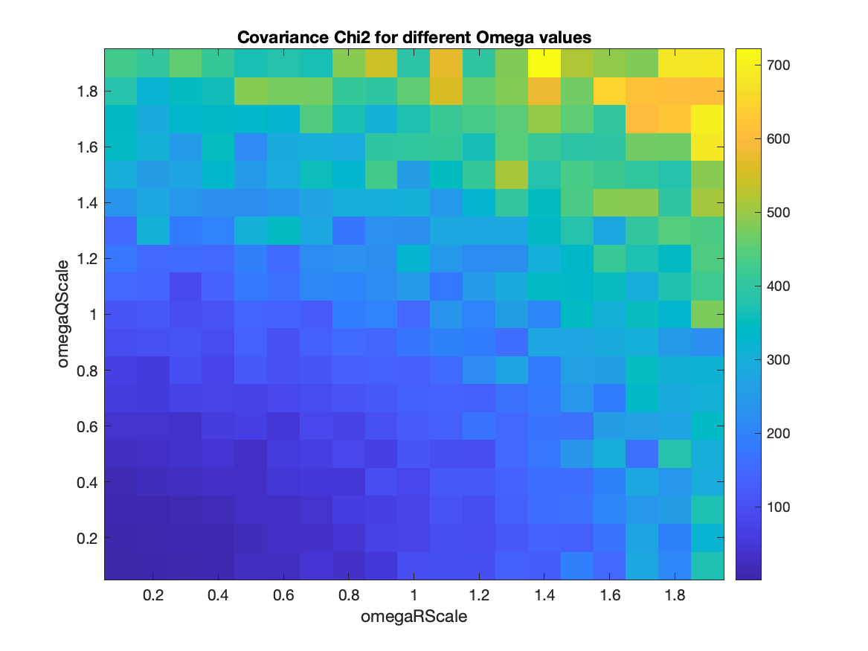
CovChi2 for Landmark Vehicle Tracking
Total number of timestep: 20
Number of episodes: 100
Number of Landmarks: 200;
Extent: 300;
numObs: /
obsPeriod: /

Slide 8
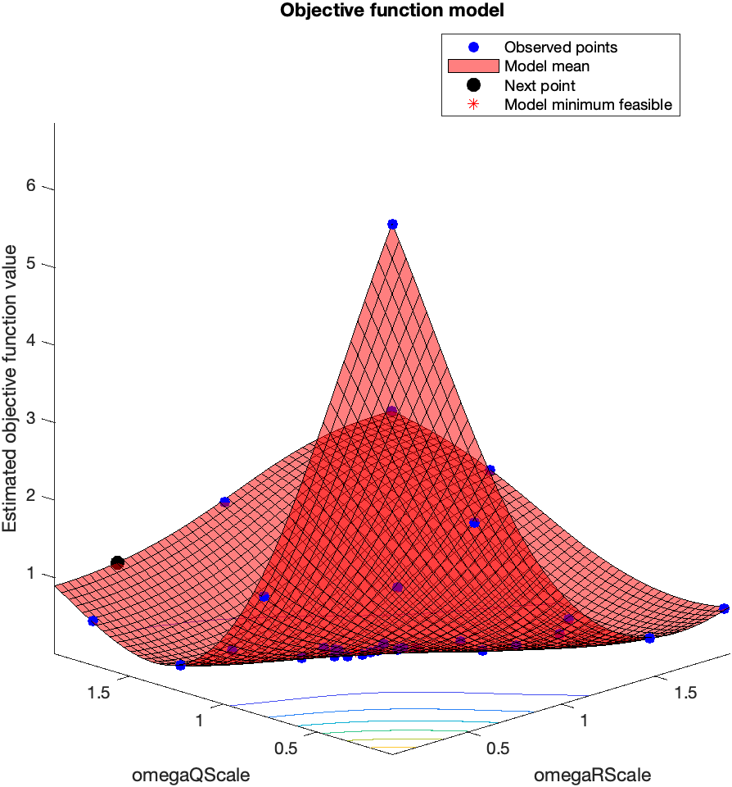
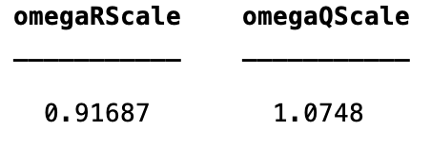
Bayesian Optimisation – GPS (Disable Proposition 4)
Total number of timestep: 20
Number of episodes: 2000
numObs: /
obsPeriod: /
AcqFunc: ExpectedImprovementPlus

Slide 9
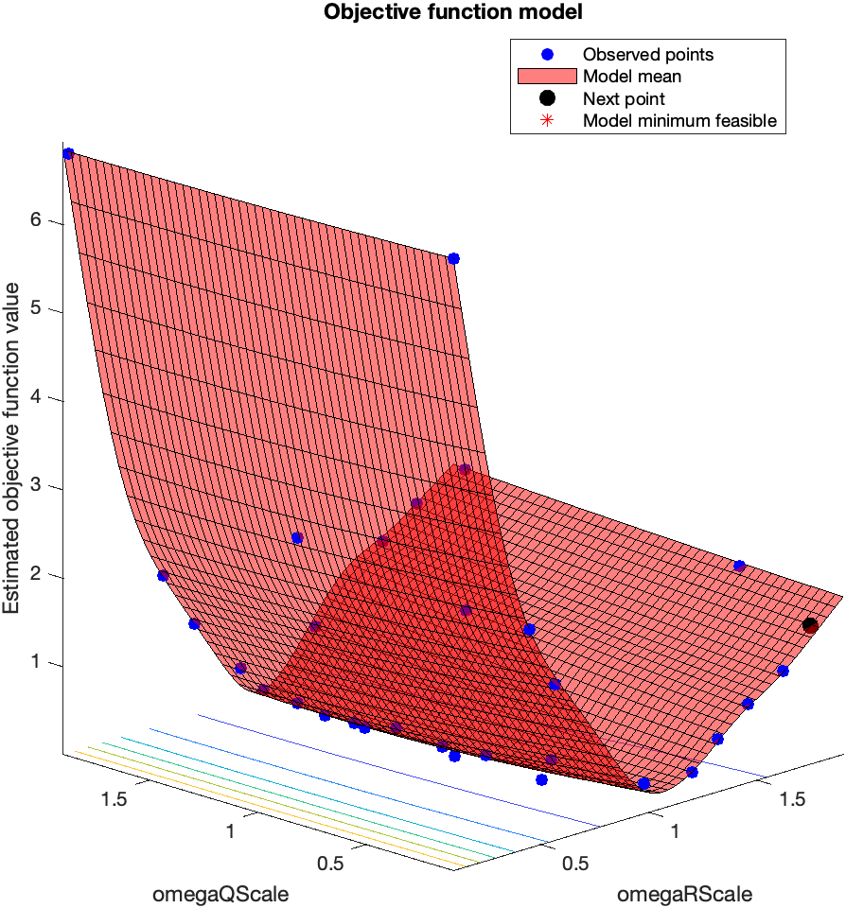
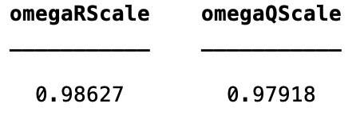
Bayesian Optimisation – GPS (Enable Proposition 4)
Total number of timestep: 20
Number of episodes: 2000
numObs: /
obsPeriod: /
AcqFunc: ExpectedImprovementPlus

Slide 10
Problems / Issues
When compute C value for VehicleTracking, the dimX and dimZ are not fixed as the landmarks are generated randomly for each run.
After fixing the landmarks for every episode, the dimX remains unchanged, but the dimZ not.
Current solution:
Take the mean value of dimZ as the final dimZ for computing number of dimensions (N)
Is there any better solution?

Slide 11
Planned Activities
Generate LandmarkVehicleTracking graphs
Explore BayesOpt
BayeOpt to learn elements in Q (GPS system)
Both R and Q (In theory)
Split graphs and compute CNEES values
Try orb-slam
Continue writing report

